Slide 1
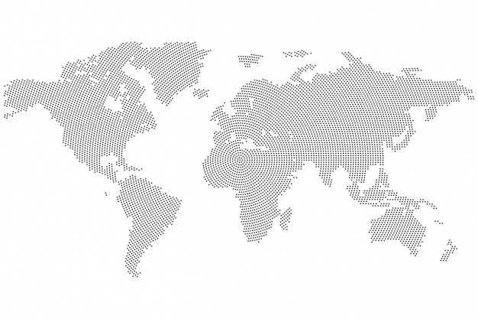
Everything is not as it seems…
Women in Data Hackathon

Slide 2
"If you torture the data long enough, it will confess to anything”.
-- Ronald H. Coase, renowned British Economist
29 Jan 2020
And that's what we did.....

Slide 3
Why are some countries doing worse than others?
Could it be for political reasons, mismanagement, or sheer bad luck?
To find out, first we have to identify who the bad performers are.

Slide 4
Why we used deaths
Confirmed cases do not reflect the full effect of the pandemic
Many cases are unconfirmed, because
Not enough tests are available
People are asymptomatic
People have to come forward to be tested
WHO uses test positivity as an indicator of measurement completeness.
We used deaths as it is a more robust value as unlike cases, all deaths will be registered. Although we recognise the measure is not without its flaws: not all countries share the same method for recording deaths caused or in the presence of covid.

Slide 5
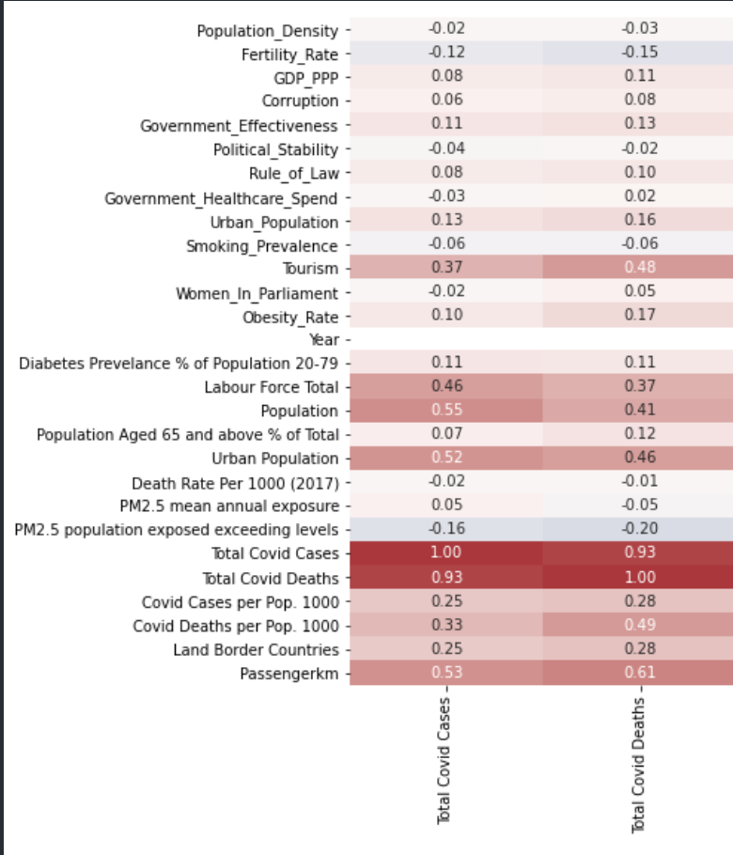
Raw COVID-19 deaths and raw COVID-19 cases are positively correlated
It is likely that cases and deaths are higher in countries with a large population simply because there are more people to catch the virus

Slide 6
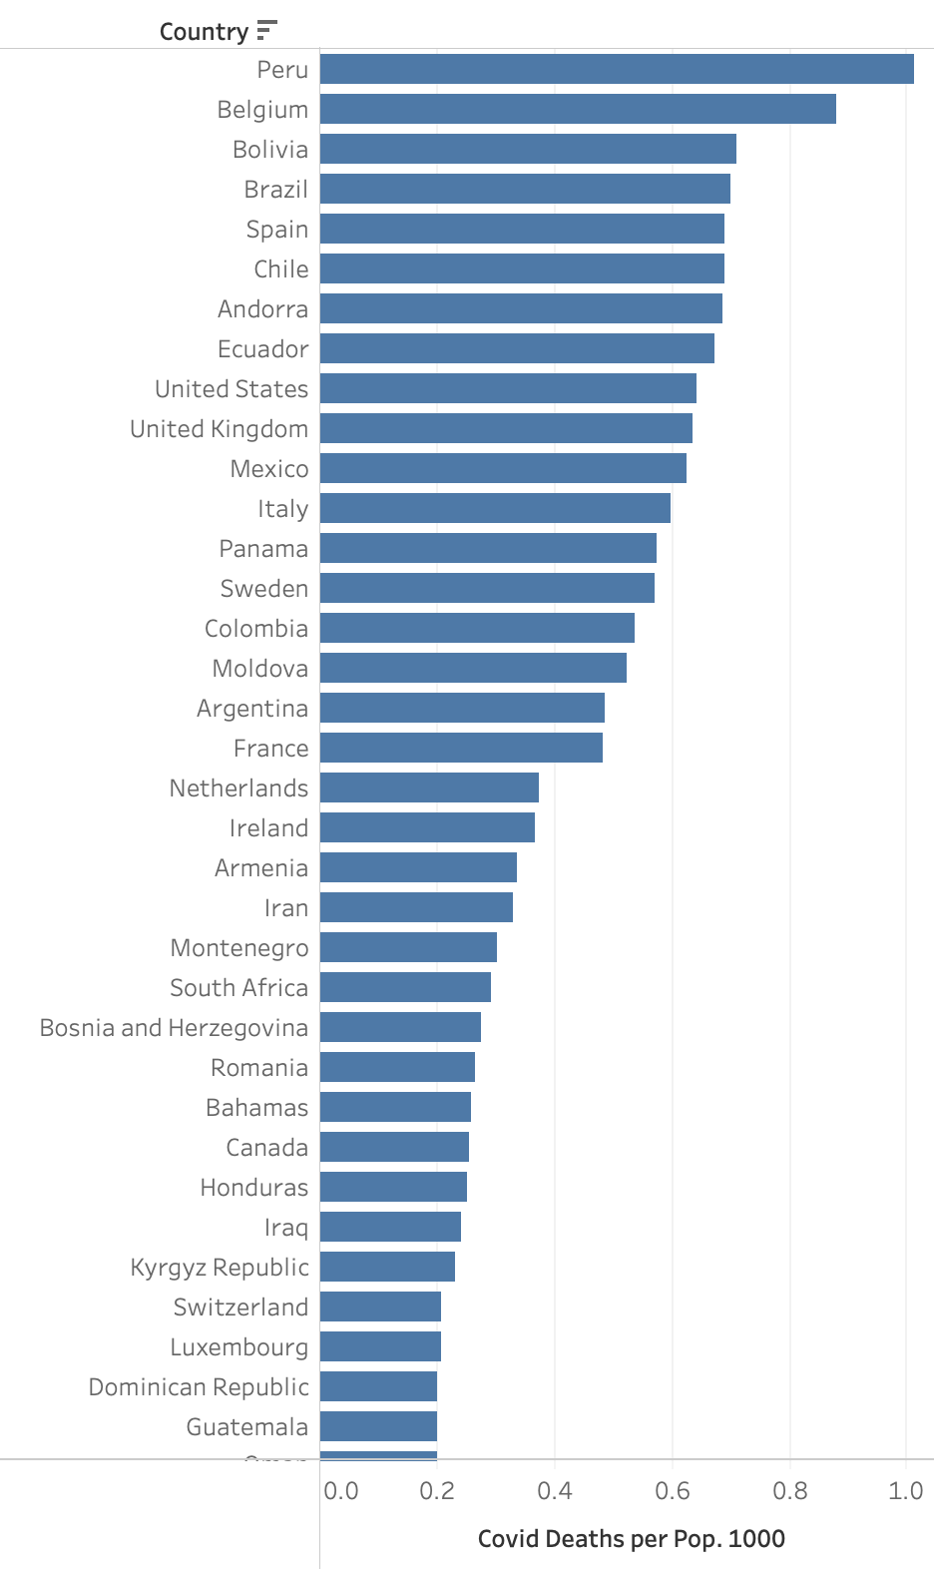
So how do we know which countries are handling the pandemic well?
A common measure is to look at
deaths per population.

Slide 7
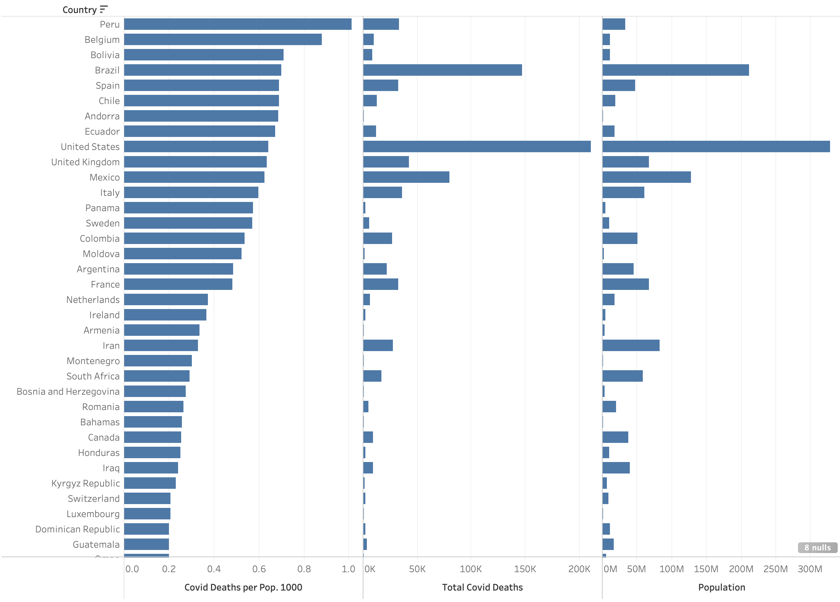
Deaths/population
When considering the raw total covid deaths and the raw total population, our theory seems to hold well. It appears that the larger the population, the larger the number of deaths

Slide 8
But is it fair to compare small countries to large countries?
Normalising the data in this way can be misleading. When normalising by size of population, small countries such as Belgium and Andorra need only a small increase in raw deaths to make a huge impact on their death/population metric.
i.e. small countries are more sensitive to this metric than larger countries. Their high cases and deaths per population, most likely due to their small population.

Slide 9
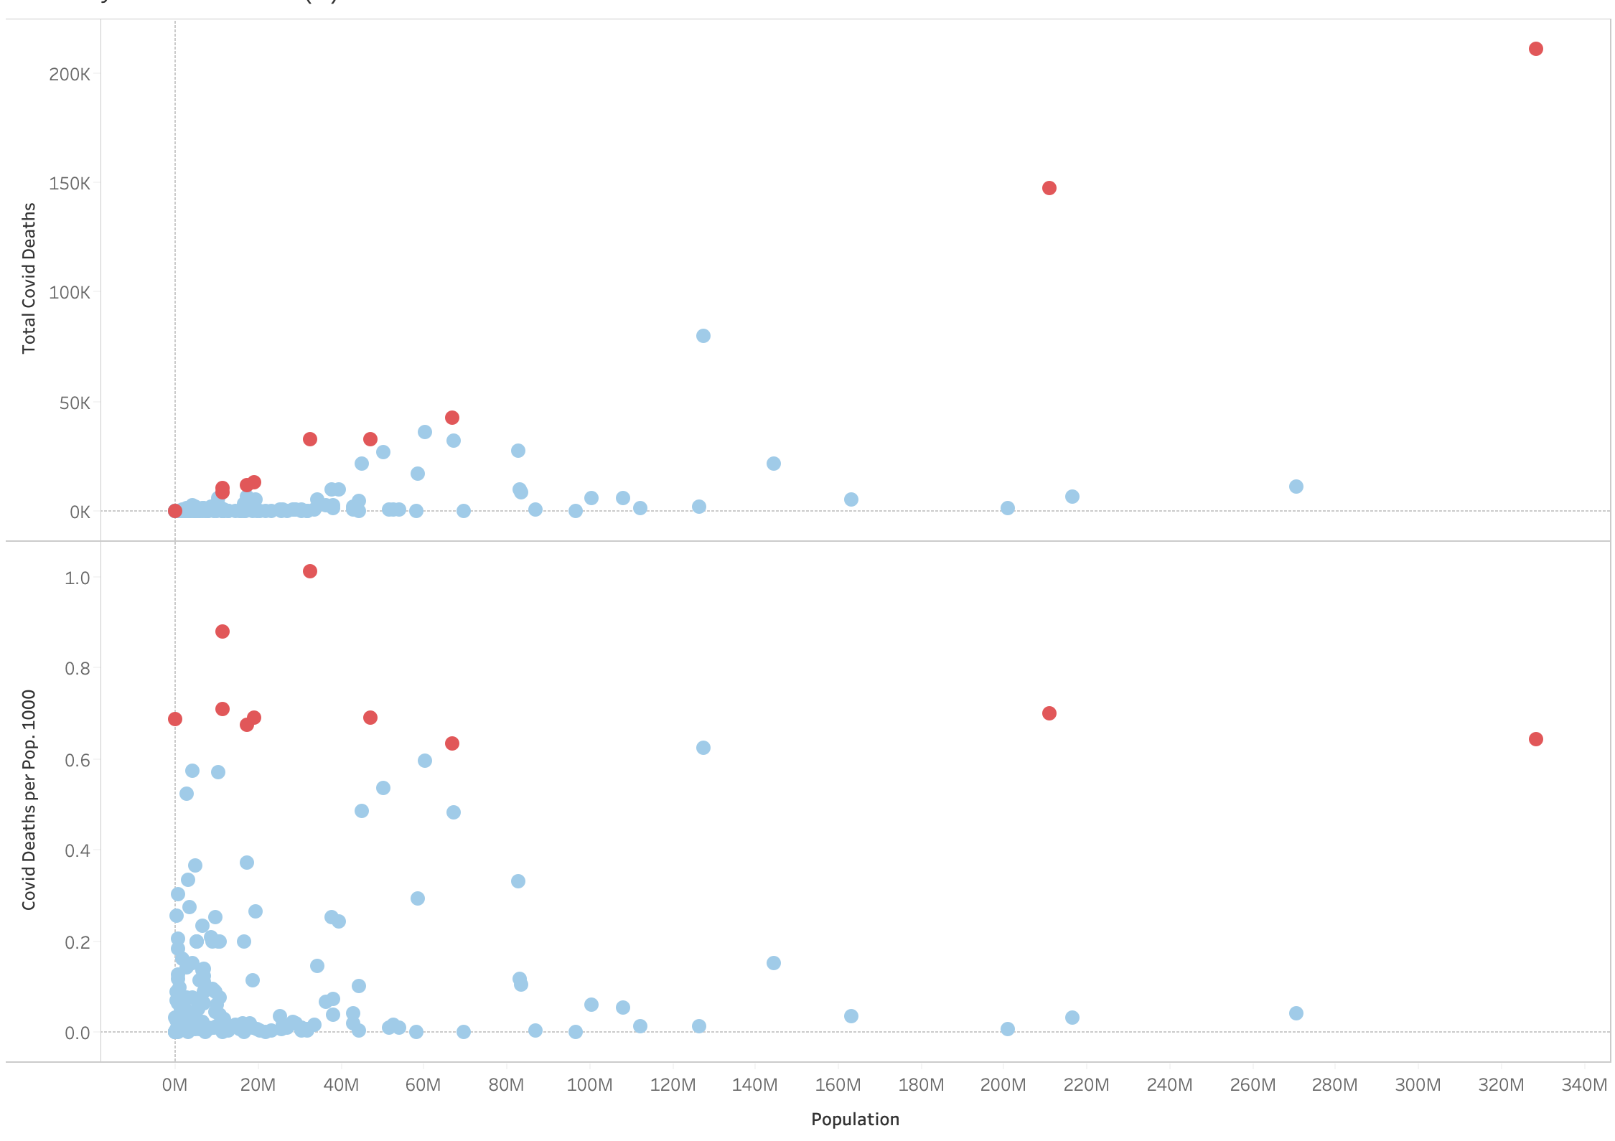
The red dots here are the 10 countries with the highest deaths per populations, and their raw death count. We see a heavy skewing of red dots to the left, which are the smaller countries (china and India excluded for scale)

Slide 10
But is it fair to compare small countries to large countries?
The challenges faced and strategies employed will also be very different between small and large countries.
It may be easier to enforce travel restrictions and internal movement on a small central country with the use of a central force, rather than in a large country where there may be dependencies on federated forces (states and counties).

Slide 11
An alternative way to measure?
Instead, we chose to compare deaths in countries of similar sizes, and to their land neighbours to have a greater understanding of their performance relative to countries of the same size.

Slide 12
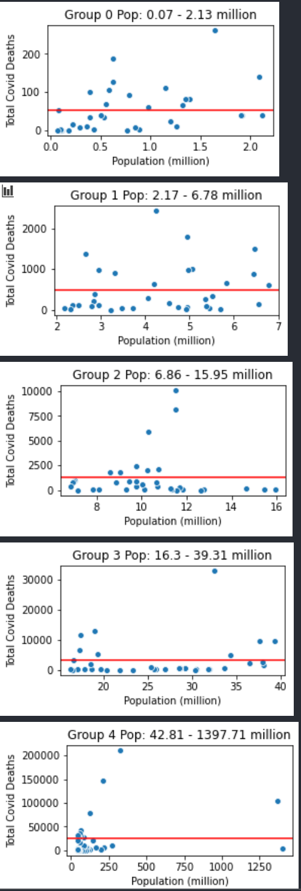
…in viewing the data by population size, we immediately see how some countries are visibly not on par with countries of a similar size
Countries are split into 5 groups, with equal number of countries in each group. Each country is represented by a blue dot and the red line is the average death count for the group

Slide 13
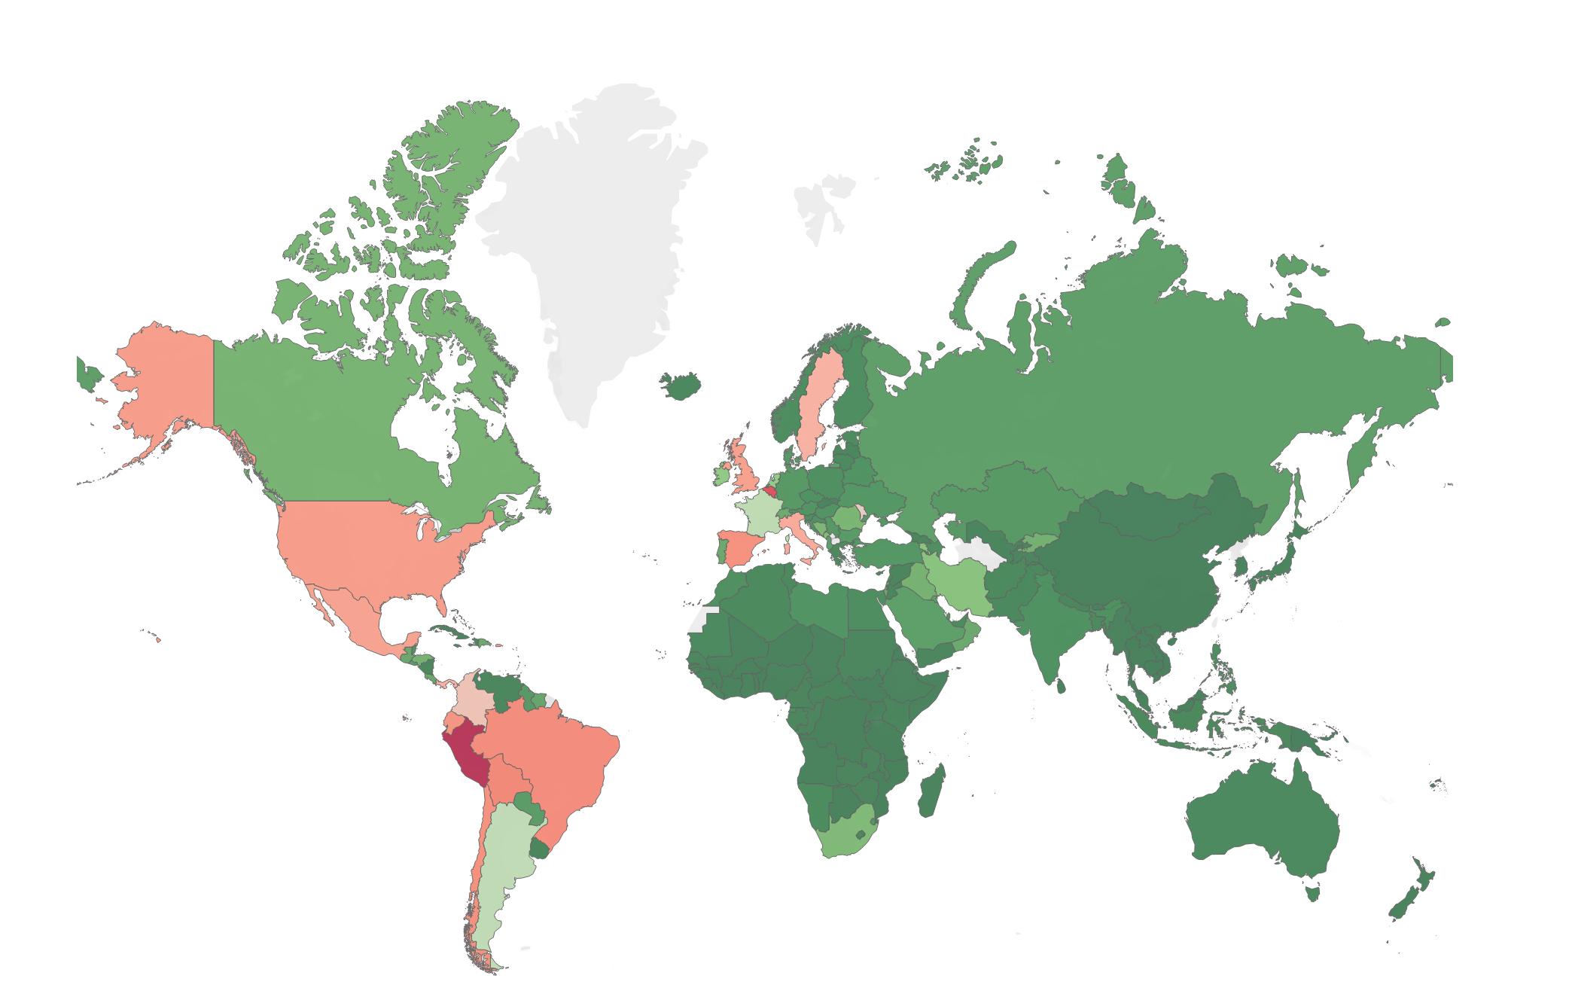
When viewing deaths per population on a geographical map (cartograph?) we see where there are clusters of countries not performing well
Countries in dark red have the highest deaths per population rates. Dark green are the lowest rates.

Slide 14

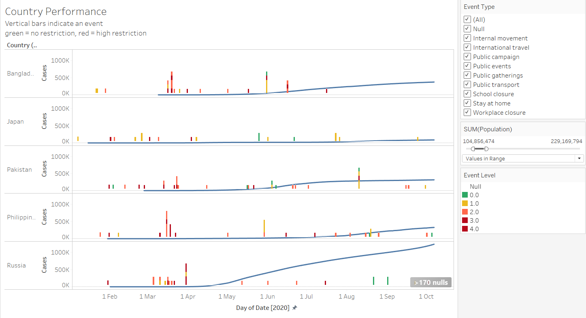
More data. Bring it on !!!
There were still some countries in the same population size group that had higher cases…So we brought in the lockdown restrictions data and looked at the influence those had on the rise in the country’s cases and deaths per population?
Insights – Russia had more cases than it’s counterparts within the same population size group and it is highly likely that’s due to the fact that it started relaxing the restrictions since May and none after August 2020, whereas the other countries continued to have some level of restrictions in place.

Slide 15
Examples
In this presentation we highlight 3 countries where things appear to be not what they seem…

Slide 16
Example 1: Andorra
Andorra is the smallest of our countries with the 10 worst deaths per population, and the second smallest in our dataset.
Population: 77 thousand
As at 7 October, registered 53 covid deaths
7th worst death per population worldwide

Slide 17
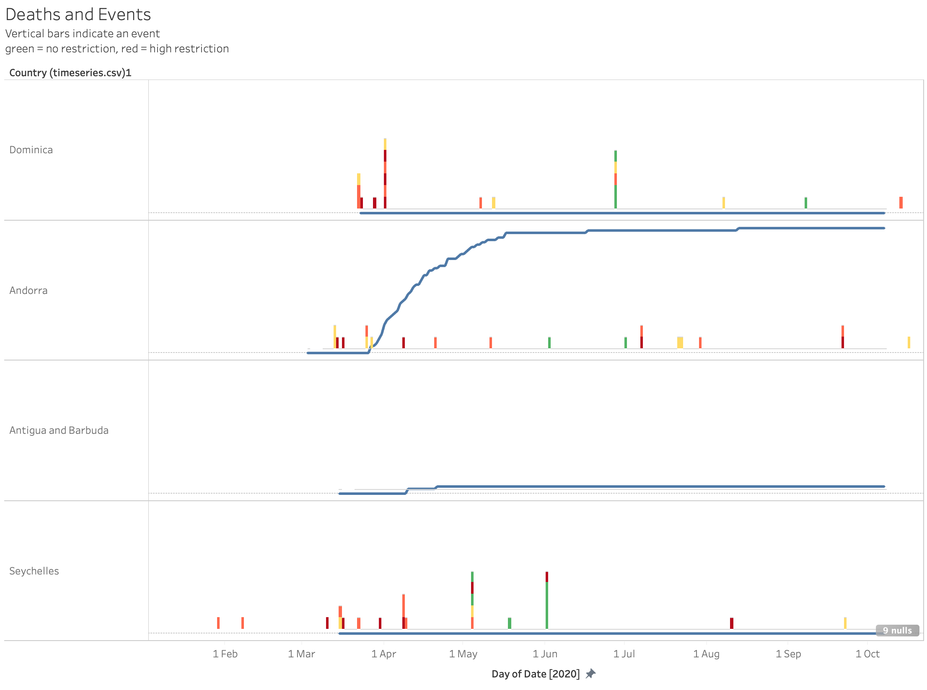
In these charts, we compare the cumulative deaths over time with the blue line, as well with information about when various restrictions were put in place or removed (changed) in the respective countries. These include restrictions on international travel, internal movement, school and workplace closures. We have called the implementation of these restrictions “events” and they are represented by the vertical bar, where green bar represents no restrictions, orange represents recommended but not enforced and red represents a legal enforcement.
In the case of Andorra, compared to 3 other countries of the same size between 71k and 97k. We see Andorra is performing badly. Dominica and Seychelles present 0 deaths whereas Antigua and Barbuda present 3.
But it is also visible that Andorra’s restriction patterns differ from the 2 other countries we can see. The other 2 countries implemented more restrictions and at higher levels and earlier than Andorra did. Both implements international travel bans in March. Andorra did not close it borders but banned high-risk regions in April, but by then it suffered 22 deaths, nearly half of its total cumulative deaths.

Slide 18
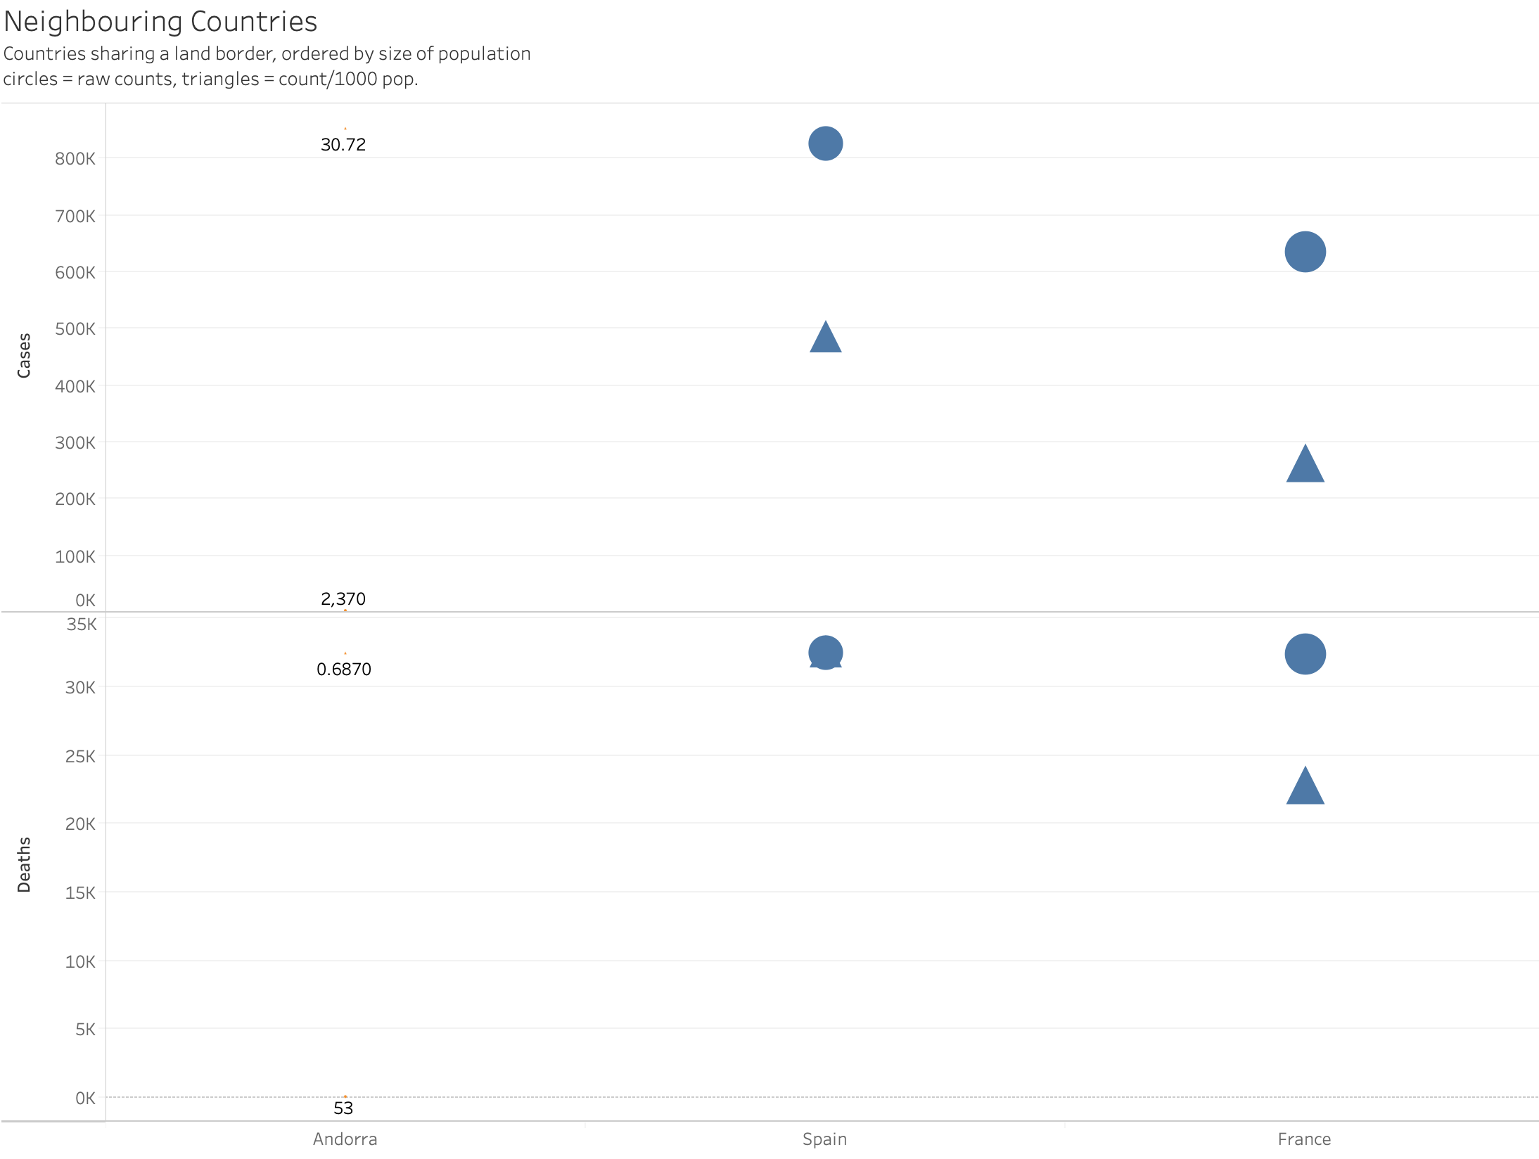
When we look at Andorra next to its neighbours, it share borders with Spain and France, both which have high case and death rates. These charts are ordered by size and the markers are also representative of size to indicate scale. In this case, Andorra is so dwarved by its neighbours, we applied the marker labels to show where it was. When we consider Andorra’s neighbours, we do not see a great deviation from its neighbours, suggesting this may be a regional situation

Slide 19
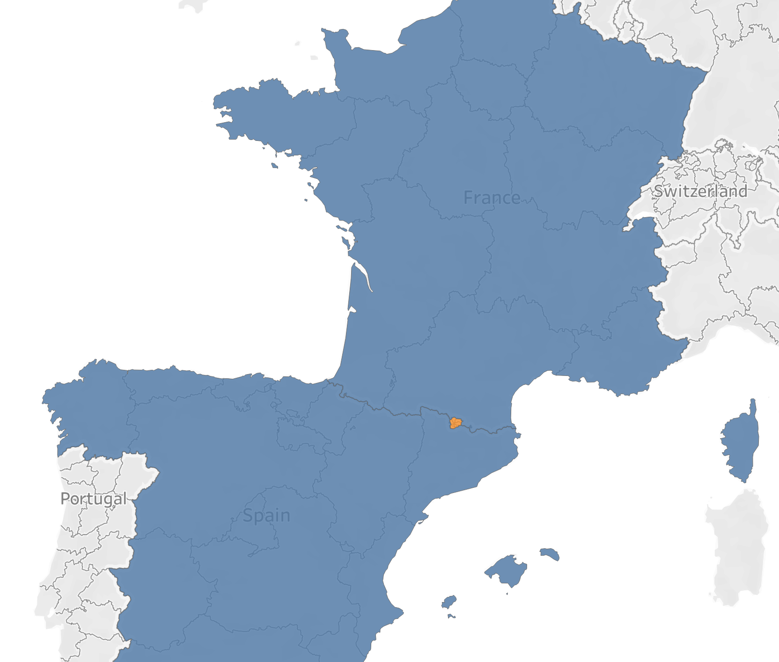
In fact when we look at Andorra on the map, it is the tiny orange splot completely engulfed by both Spain and France. It is little wonder then that Andorra’s death rate is similar to its neighbours. It is worth noting that Spain and France are in 5th and 18th position for deaths per population.

Slide 20

Example 2: Sweden
Population: 10.28 million
As at 7 October, registered 5,883 covid deaths
14th worst death per population worldwide
We chose Sweden because of its unconventional approach to lockdown, or rather, the lack of any lockdown.

Slide 21
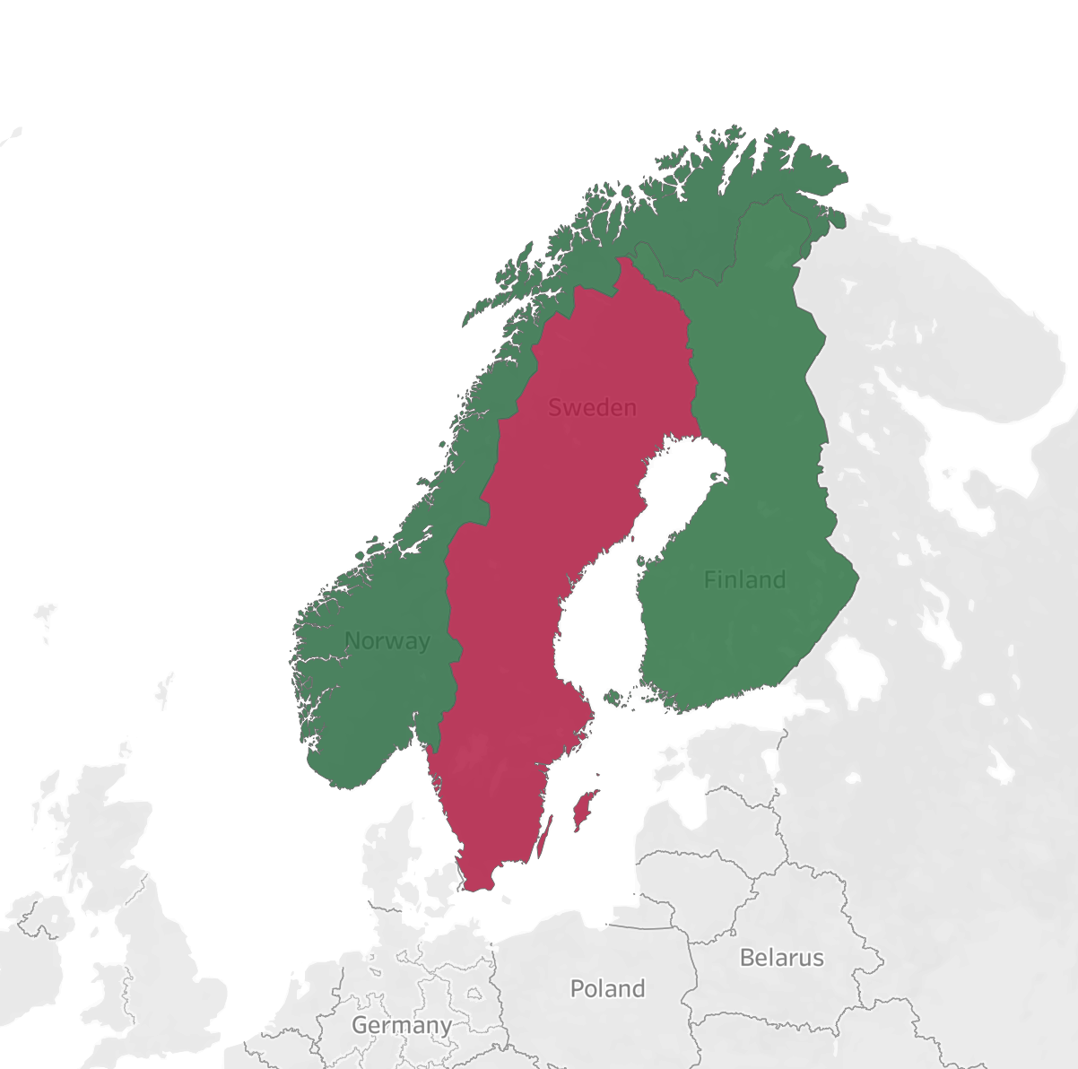
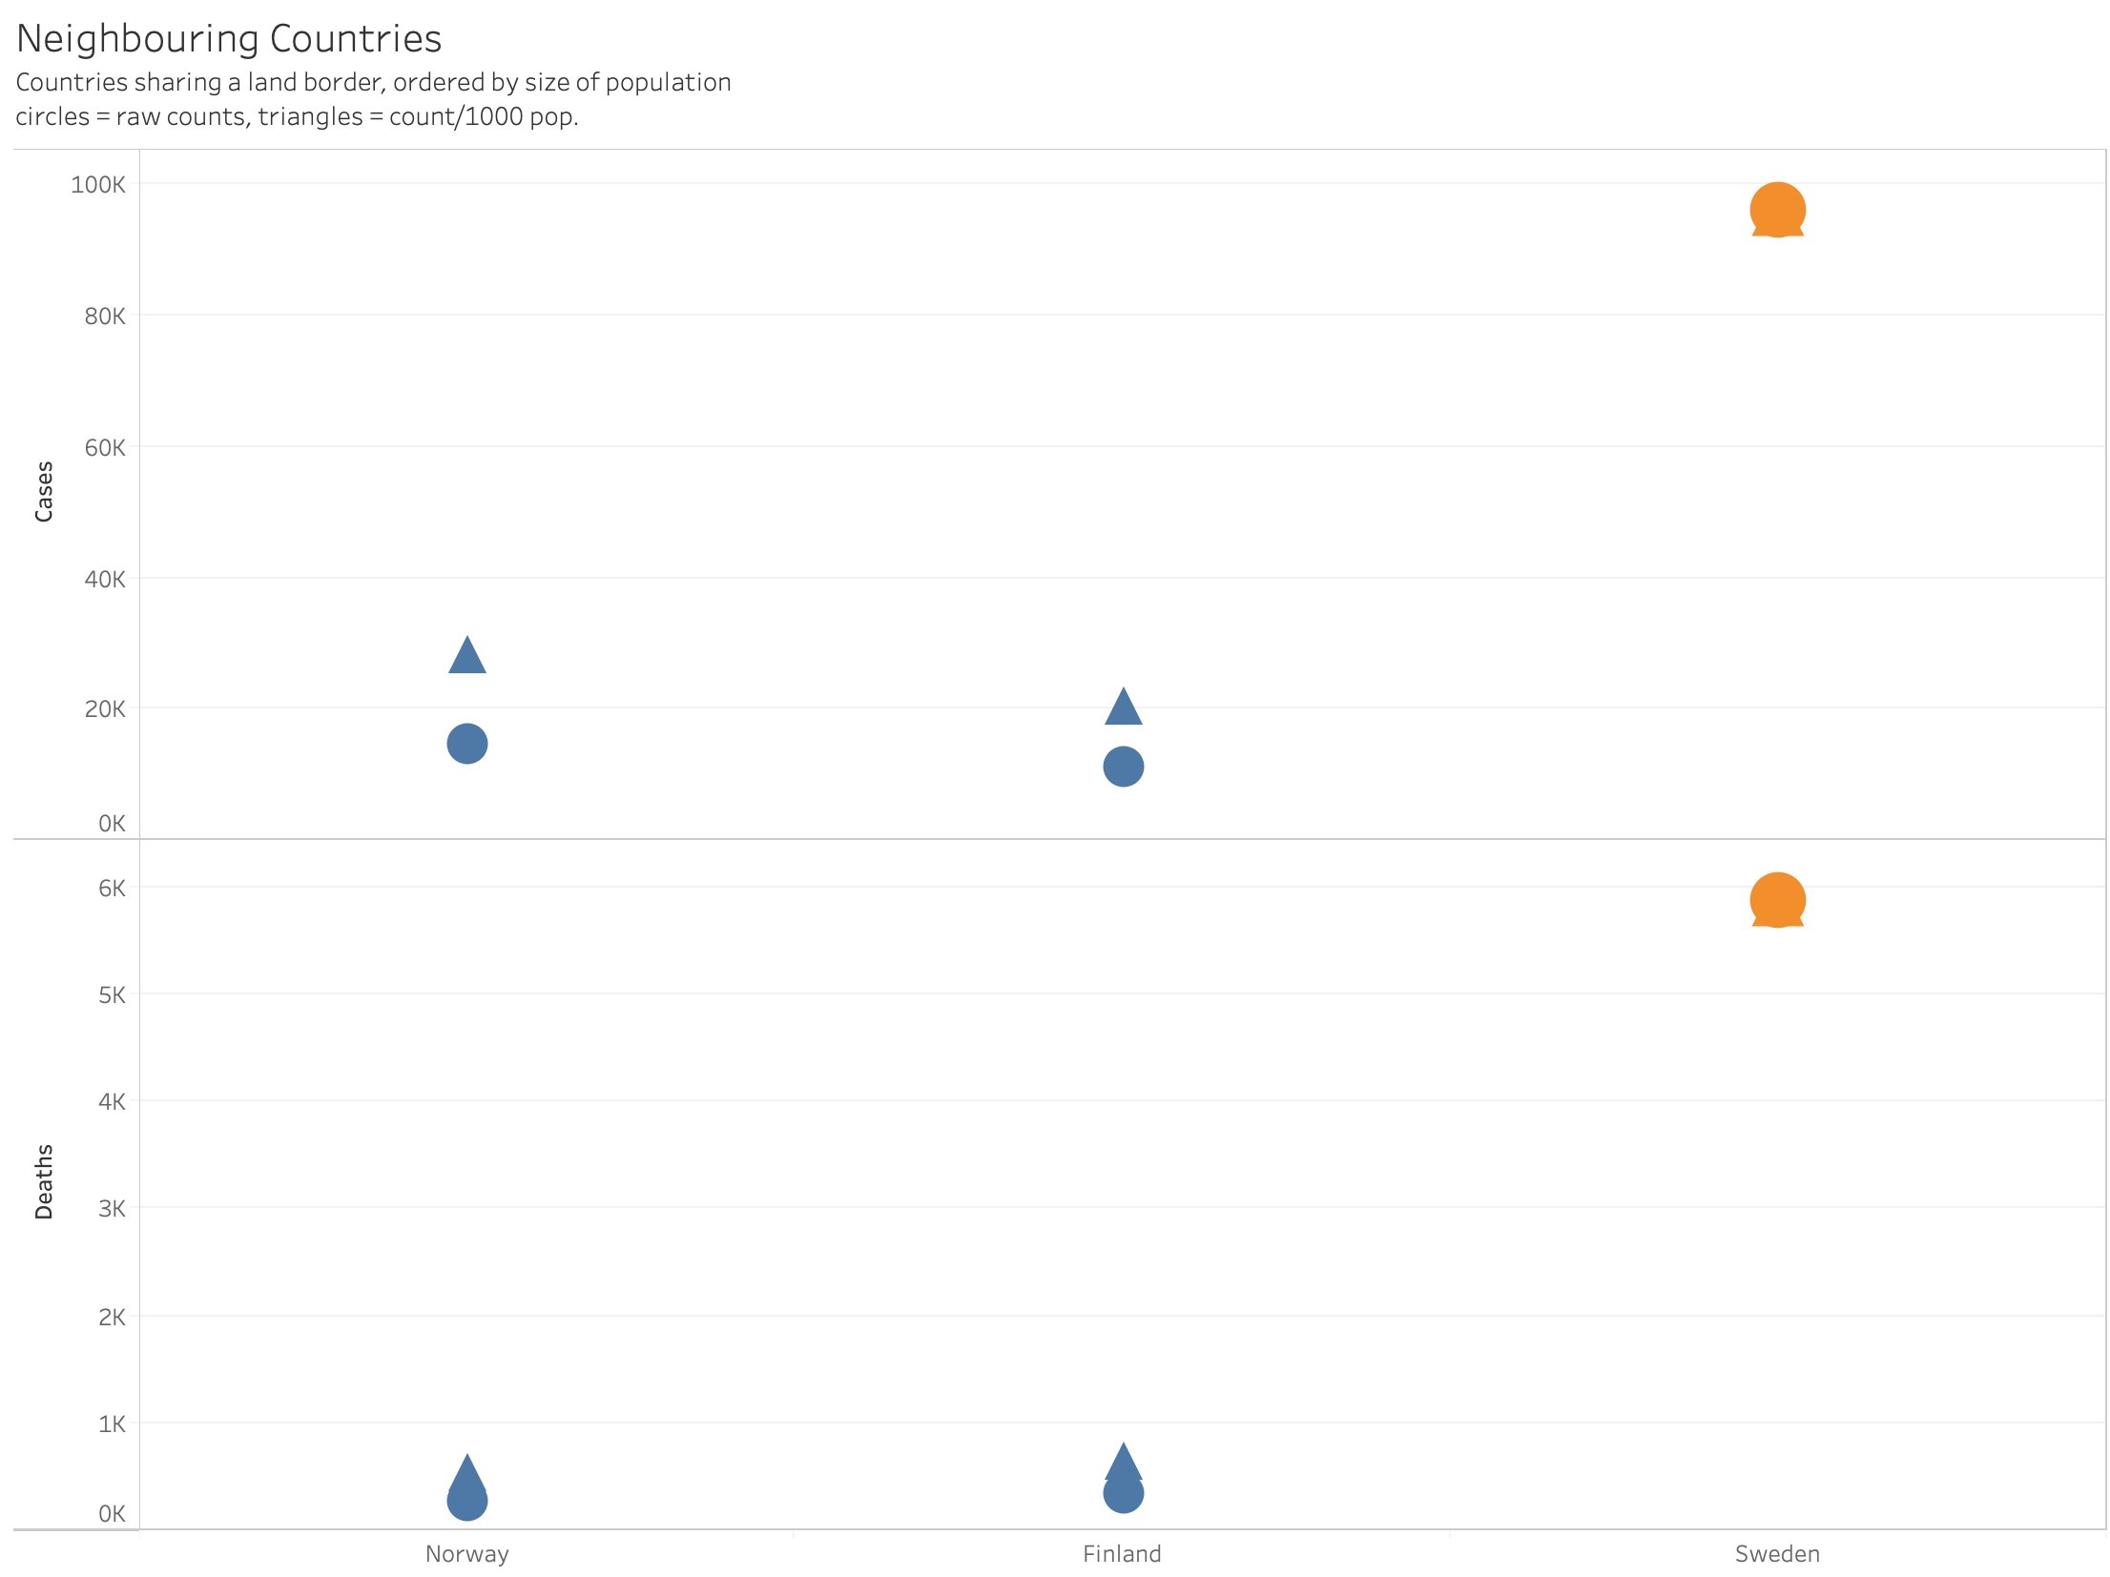
Here we see Sweden has not fared well compared to its two land neighbours of Norway and Finland.

Slide 22
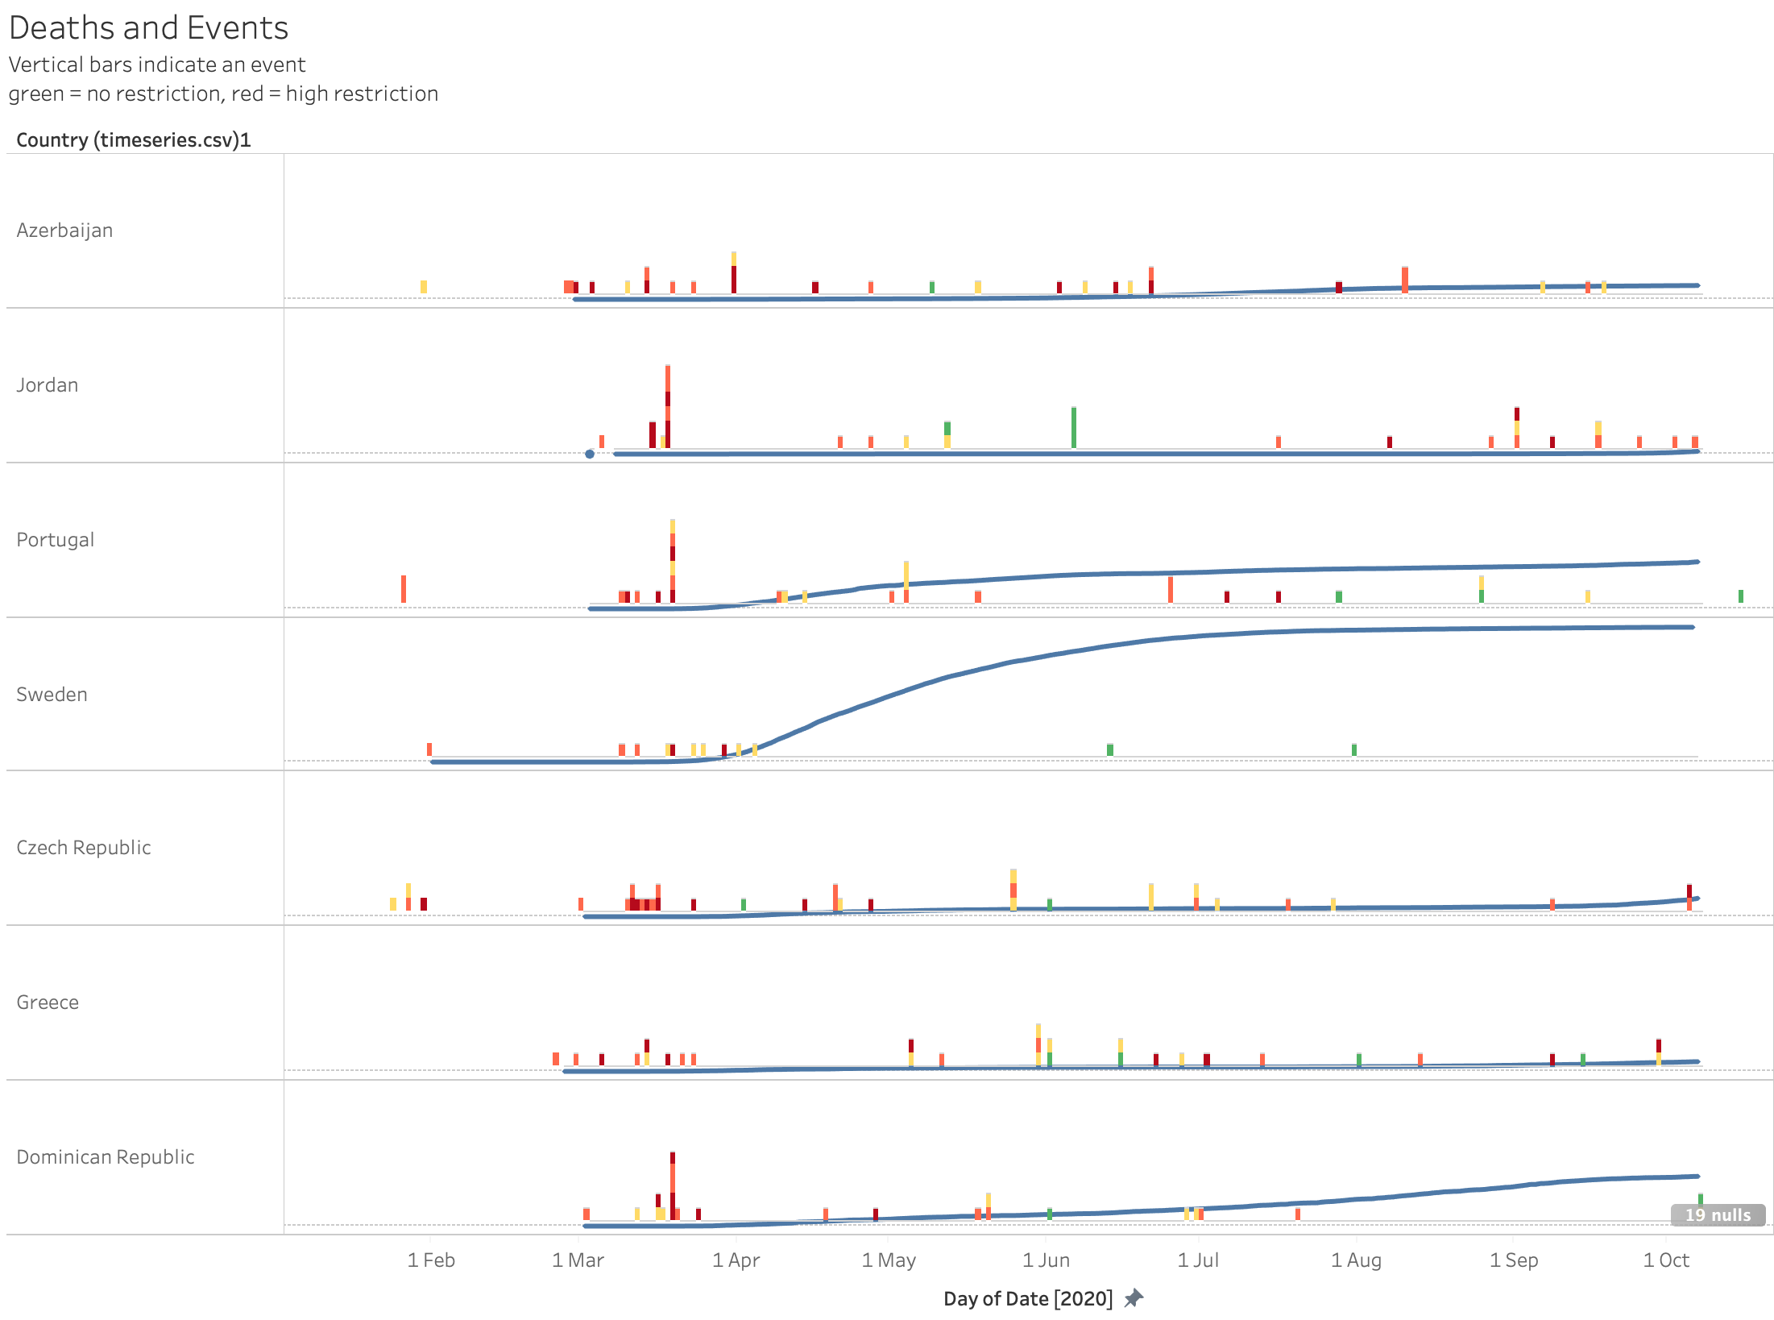
When we consider events compared to countries of the same size (all between 10-11million), it is evident Sweden did not enforce as many restrictions or with as much intensity as other countries of similar size. Sweden made mere cautionary remarks and only enforced restrictions on international travel and gatherings above 100 people.
Also unlike with other countries, Sweden did not modify its restrictions at any point beyond the outbreak, except to lift any previous advice to refrain from internal movement and recommendations but not enforced restrictions on schools.
Yet despite this complete lassiez-faire approach, Sweden’s death rate per population is only 14th worldwide, rising early in the pandemic but levelling out in the summer, whereas we see the Dominican and Czech Republics starting to see an increase at the start of the autumn, on the back of lifting restrictions (yellow and greens) after enforcing them early in the pandemic (red)
Only time can tell now if other countries will surpass Sweden further given the changes in their restrictions

Slide 23
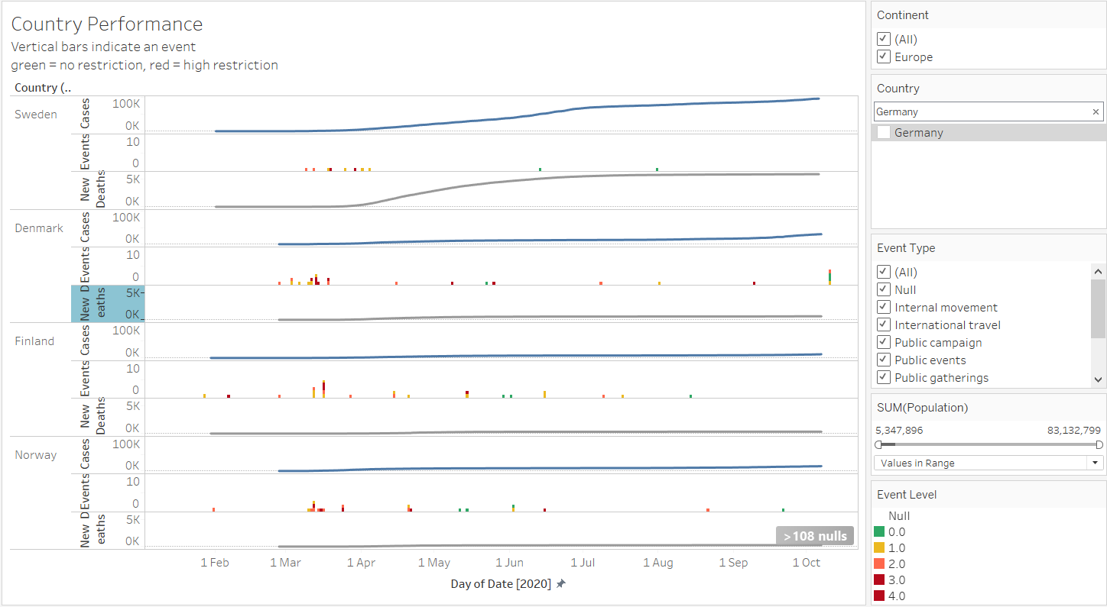
How about Sweden ? - the most talked about country for it’s strategy to tackle COVID-19. Has its no-lockdown strategy back-fired ?
…And our answer to the question is “Yes”. When compared to its Nordic neighbours, Sweden had steep rise in new cases as well as deaths since May 2020 and with no restrictions in place, whereas its neighbouring countries have been able to keep the new cases at low and reduction in deaths.

Slide 24
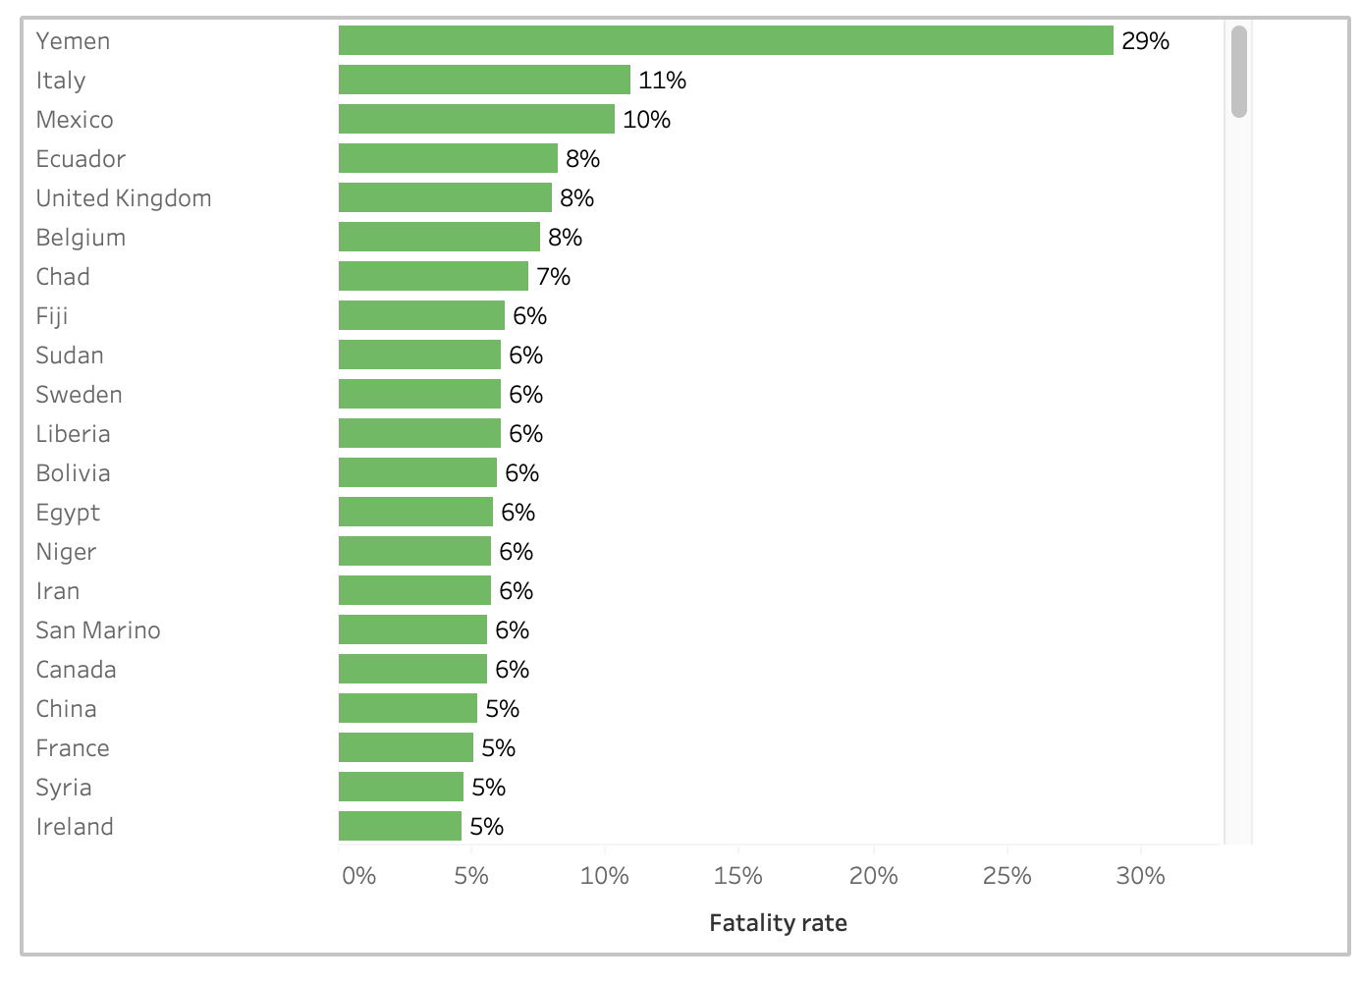
Example 3: Yemen
Population: 29.16 million
As at 7 October, registered 593 covid deaths
We chose Yemen not for its position in Deaths per population, but for Deaths per case, or case fatality rate where it comes up at the top. On the surface, it would seem that if you had caught covid in Yemen, you were significantly more likely to die from it than anywhere else in the world. So we wanted to look at this in a bit more detail.

Slide 25
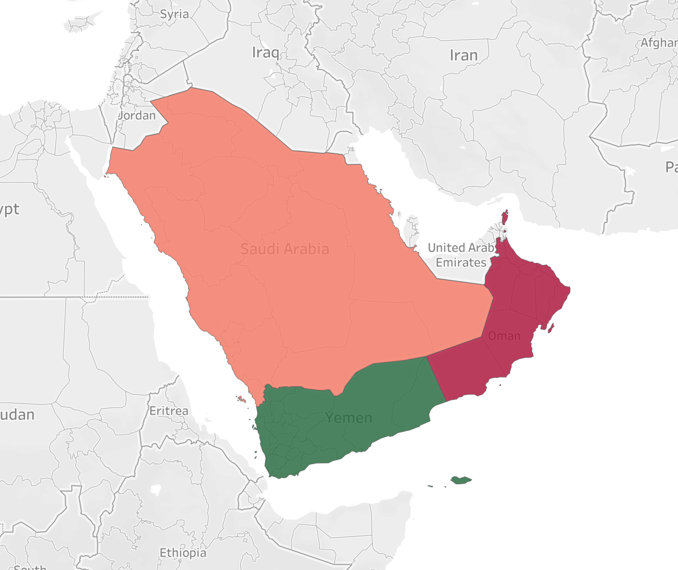
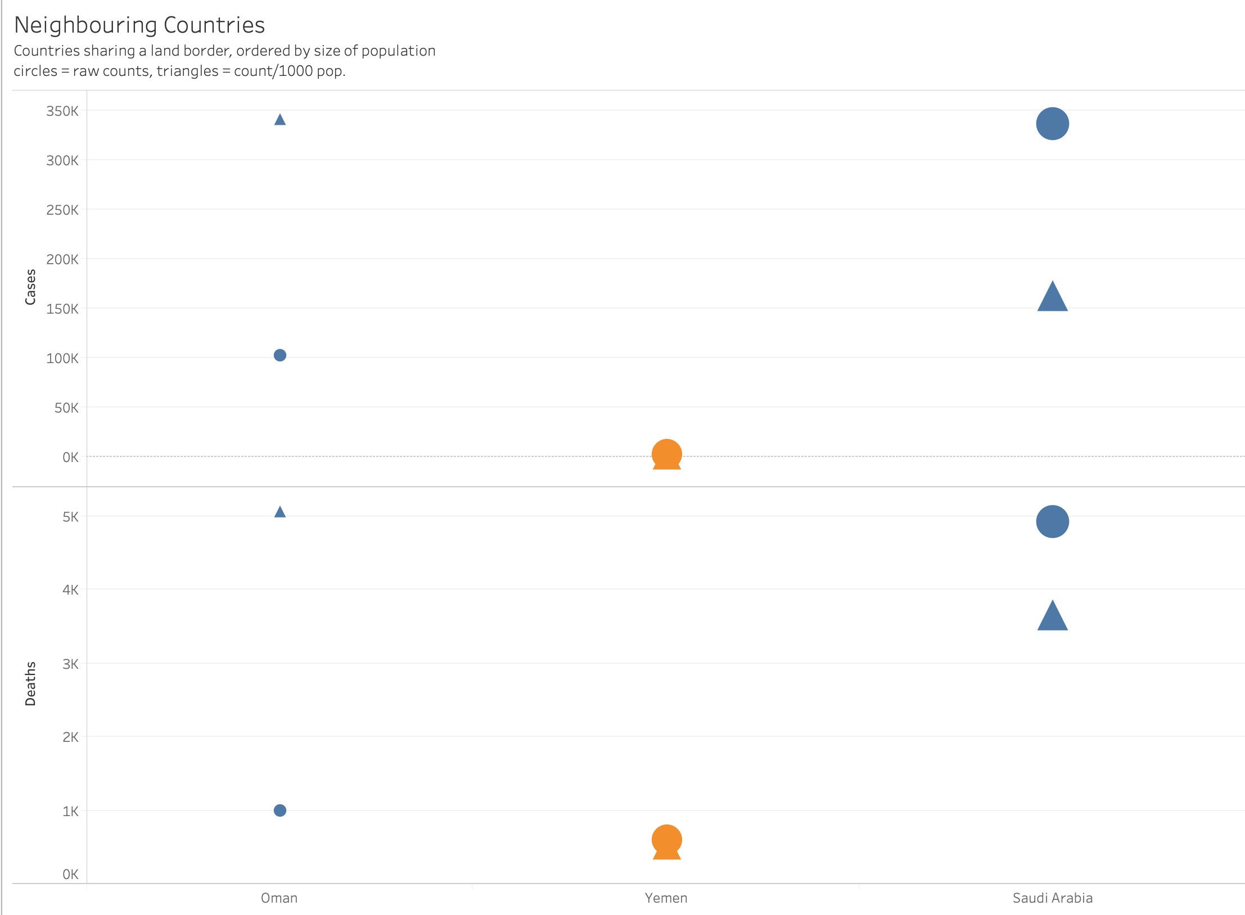

Slide 27
Summary
Why things aren’t always what they seem:
Andora had high death per population, but on inspection, it appears to just have been dwarved by Spain and France
Sweden looks like it has done badly by its neighbours and countries of the same size, yet when looking at the trends, a change in lockdown activity seems to lead to an increase in deaths, which Sweden doesn’t see but instead appears to have plateaued.
Yemen appears to be the deadliest place in the world if you have contracted covid, yet when comparing to its neighbours and considering current events, the high CFR may be instead due to quality in the number of cases confirmed.

